Slide 1
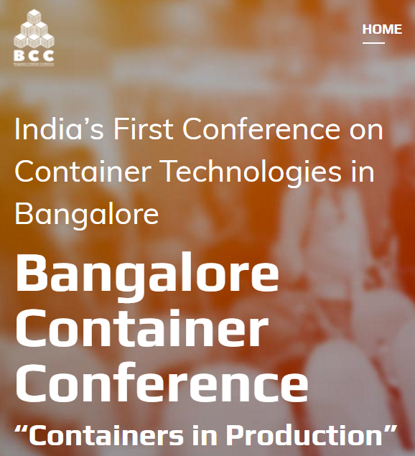

Contribution to CNCF Various ways – Not source code alone……
7th April 2017
Krishna Kumar
CNCF Ambassador

Slide 2
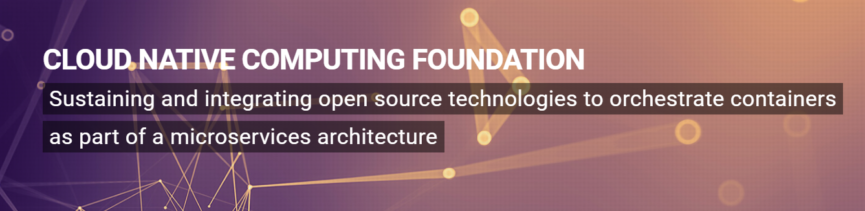
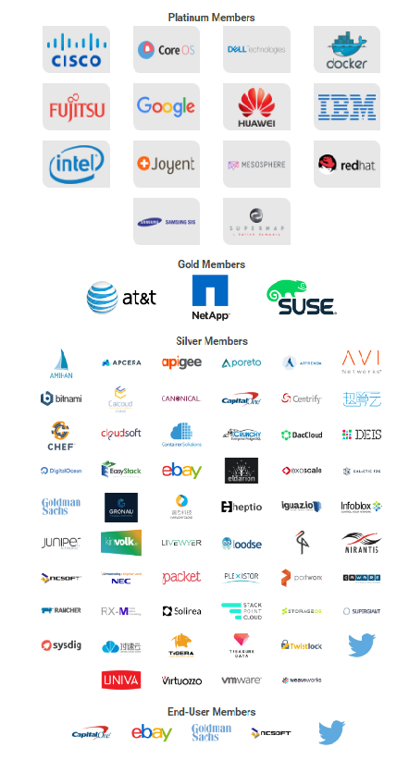
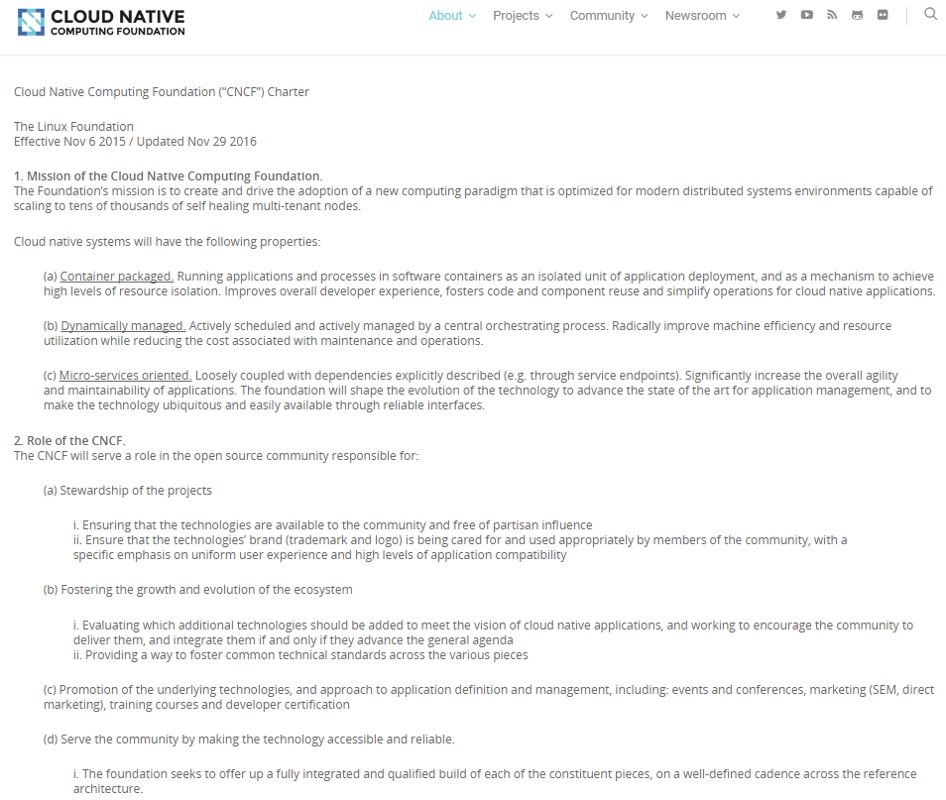

Slide 3
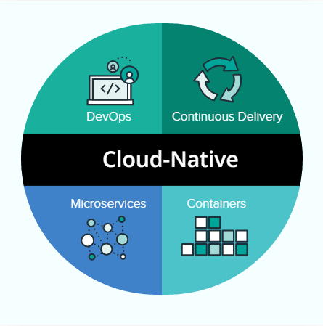
What is cloud native
Cloud-native applications are purpose built for the cloud model. These applications—built and deployed in a rapid cadence by small, dedicated feature teams to a platform that offers easy scale-out and hardware decoupling—offer organizations greater agility, resilience, and portability across clouds. Pivotal
At the heart of "cloud-native" lie Linux, Linux containers, and the concept of applications assembled as microservices in containers. Indeed, the Linux Foundation launched the Cloud Native Computing Foundation. But cloud-native means a lot more than implementing Linux clusters and running containers. It's a term that recognizes that getting software to work in the cloud requires a broad set of components that work together. It also requires an architecture that departs from traditional enterprise application design. . Charles -informationWeek
12 factors (solid principle for Cloud Native Software Architecture)
Codebase
Dependencies
Build, release, run
Backing Services
Processes
Port binding
Concurrency
Disposability
Dev/prod parity
Logs
Admin processes
Config
One codebase tracked in revision control, many deploys
Explicitly declare and isolate dependencies
Store configuration in the environment
Treat backing services as attached resources
Strictly separate build and run stages
Execute the app as one or more stateless processes
Export services via port binding
Scale out via the process model
Maximize robustness with fast startup and graceful shutdown
Keep development, staging, and production as similar as possible
Treat logs as event streams
Run admin/management tasks as one-off processes
Here’s how a blog on IBM’s developer web site distinguishes the two adjectives Cloud-Native and Cloud-Enabled:
You can say that a cloud-enabled application is an application that was moved to cloud, but it was originally developed for deployment in a traditional data center. Some characteristics of the application had to be changed or customized for the cloud. On the other hand, a cloud-centric application (also known as cloud-native and cloud-ready) is an application that was developed with the cloud principles of multi-tenancy, elastic scaling and easy integration and administration in its design.

Slide 4
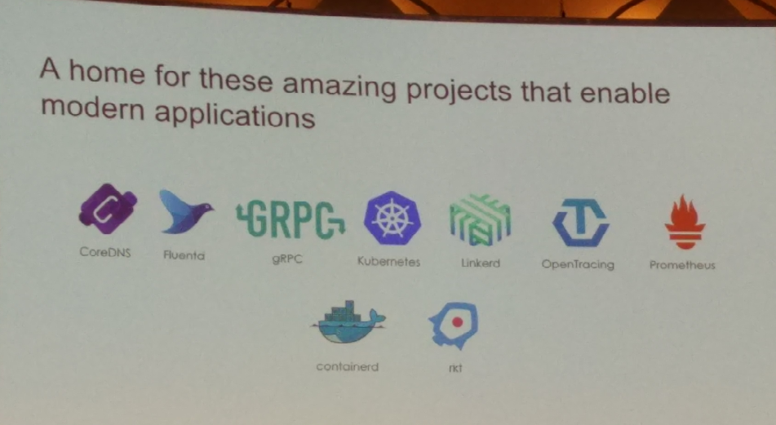
CNCF Projects
Kuberenets - Deployment & managing containers
Fluentd - Logging to unify data collection
Linkerd - Proxy for service discovery and routing
OpenTracing - Distributed tracing
Prometheus - Monitoring with metric & alerting
GRPC - Define services using Protocol buffers
CoreDNS - Service Discovery for Cloud
Containerd - Container runtime by Docker
Rkt - Pod-native container engine for Linux
All these projects are available at github.com

Slide 5
There are several other open source projects in incubation stage at present and some of them may move to the graduate status soon. Some of those projects may be:
CockroachDB - Database
OpenZipkin - Tracing
NATS - Messaging
Heron - Stream Processing
Calico/Weave - Networking
etcd - Configuration
Minio - Storage
GitLab - Repository for code, test, deploy
RethinkDB - Distributed database for real time web apps – just got into Linux Foundation but not part of CNCF yet.

Slide 6
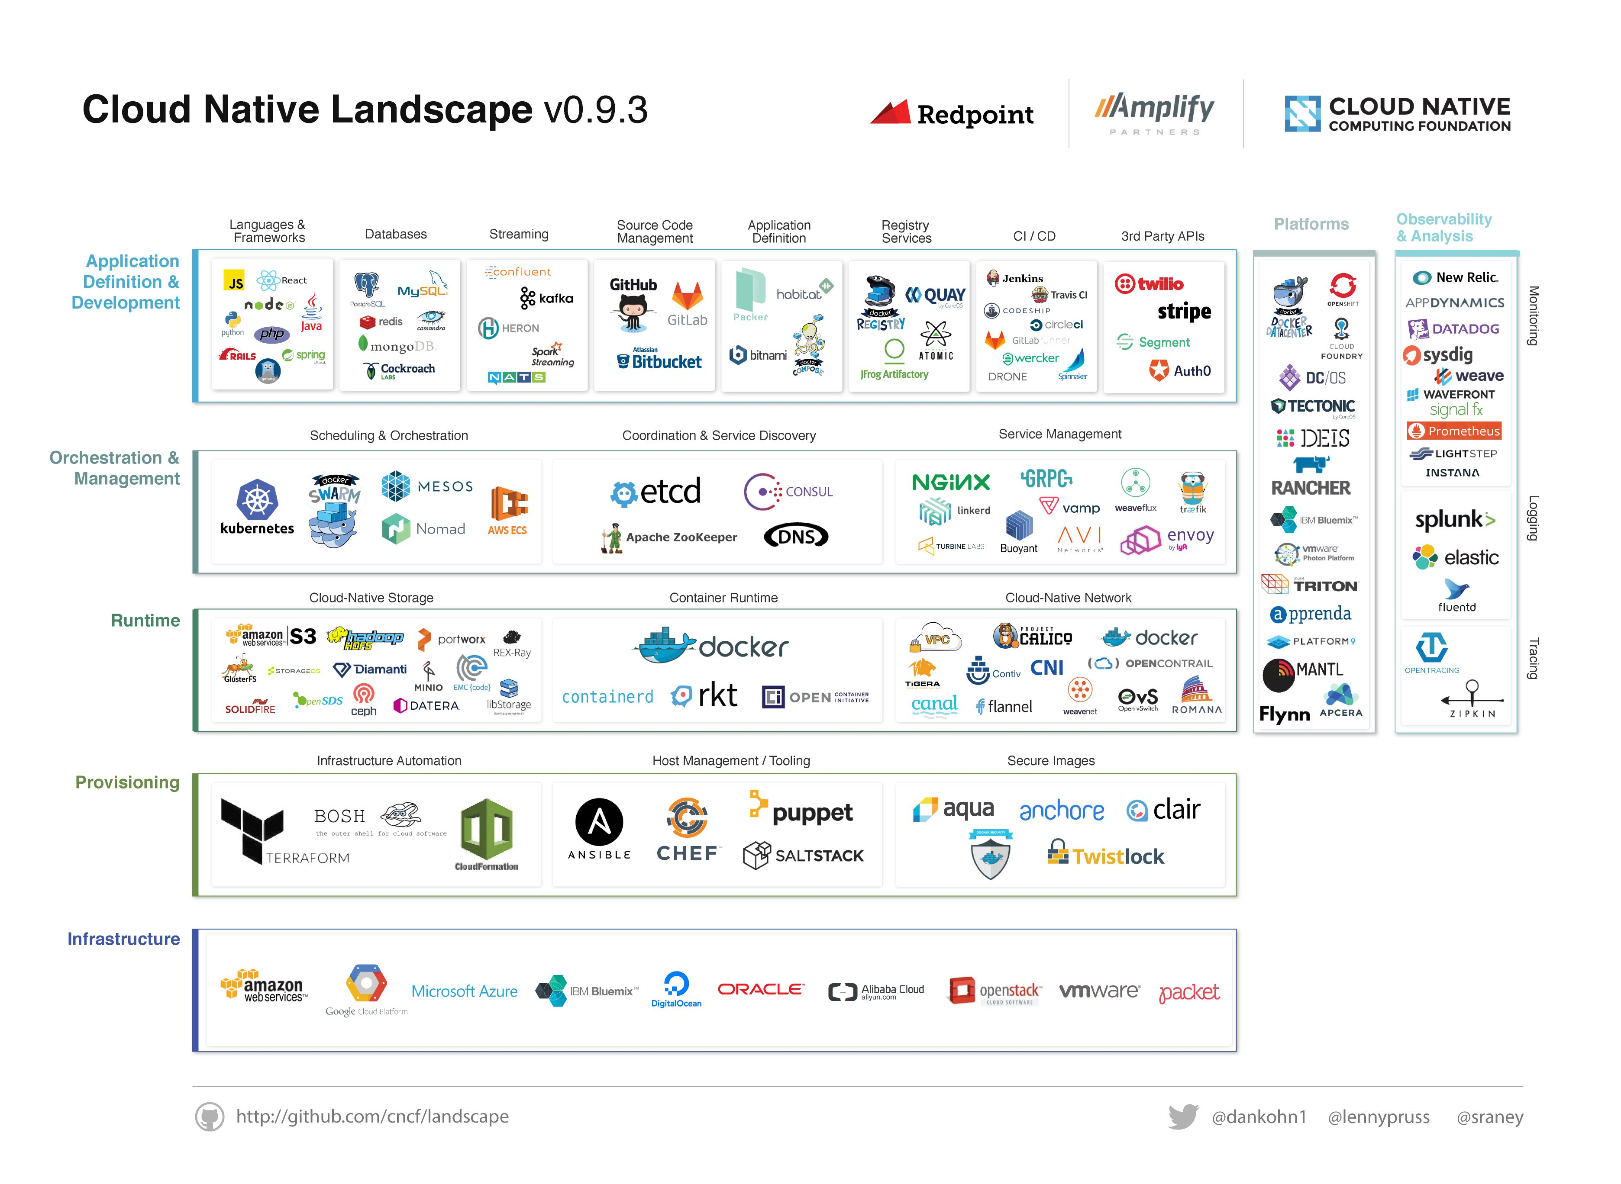

Slide 7
CNCF Leadership Team
The leader ship team Executive Director is Dan Kohn, who helped create Linux Foundations Infrastructure initiative. Their COO Chris Aniszczyk, who is the former head of Twitter’s open source, is another key person in the foundation. There are other project managers and event coordinators in the leadership team to keep the foundation in good shape.
The governing board of the CNCF consists of people from Coreos, Weaveworks, Mesosphere, Samsung, Docker, Redhat, Supernap, Cisco, Fujitsu, Apcera, Google, Intel, Huawei, Joyent, Apprenda, IBM, NetApp. The board looks into business oversight of the foundation.
The technical over sight committee (TOC) includes Alexis Richardson WEAVEWORKS (TOC CHAIR), Ben Hindman MESOSPHERE, Brian Grant GOOGLE, Bryan Cantrill JOYENT, Camille Fournier INDEPENDENT, Elissa Murphy GOOGLE, Jonathan Boulle COREOS, Kenneth Owens CISCO, Solomon Hykes DOCKER and Quinton Hoole from huawei. These people drive the direction of the foundation on core technology decisions. They define and maintain the technical vision, approve new projects, align interfaces and practices.
More details here: https://www.cncf.io/about/technical-oversight-committee

Slide 8

How to contribute

Slide 9
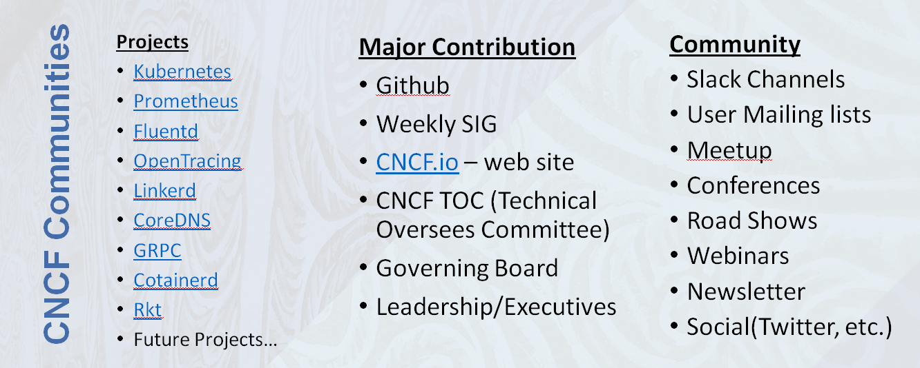

Slide 10
SIG & WG Program
There are SIG programs available for various CNCF projects. Like the one shown for Kubernetes https://github.com/kubernetes/community/blob/master/README.md#special-interest-groups-sig,
These groups meets weekly and discuss the community activity mainly technical in nature. There are various workgroups one can sign up.
Also you could start a new SIG as shown below https://github.com/kubernetes/community/blob/master/sig-creation-procedure.md

Slide 11
Source Code
One of the prominent contributions to the open source community is in the form of source code. There is specific governance provided by the Kubernetes community to contribute source and documents. More here: https://github.com/kubernetes/community/blob/master/governance.md
From it, one can see there is a hierarchical structure of contribution status and one could become a maintainer or project approver in due course. Similar models may be applicable to other projects in the CNCF.
The project statistics available here: https://cncf.biterg.io/app/kibana#/dashboard/Overview shows a glimpse of the contribution made to each CNCF projects by the partner companies. It may be upgraded to get the individual level details of the contribution.

Slide 12
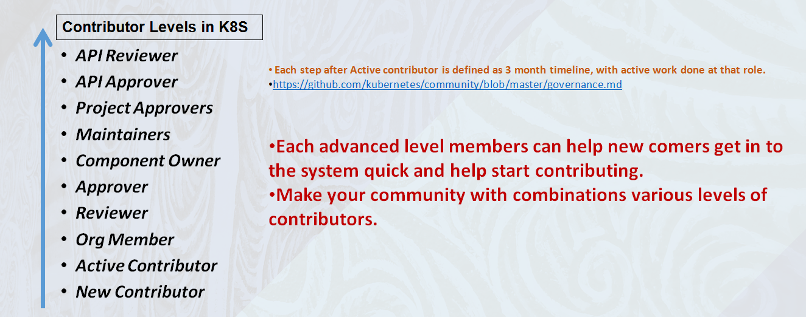

Slide 13
Creating a new project
If you have a new project to propose to CNCF please go through the document shown in the link https://github.com/cncf/toc/blob/master/process/project_proposals.adoc
You start with proposing the project to the Technical Oversight Committee (TOC) and based on the vote in TOC it may get accepted to the inception, incubation or graduate stage. The process is the same for both existing projects which seek to move into the CNCF, and new projects to be formed within the CNCF.
To graduate from inception or incubation status, the project must meet the criteria as shown in the link https://www.cncf.io/projects/graduation-criteria
Cluster Setup
You can help setting up CNCF test bed at local or supporting existing cluster setup available https://github.com/cncf/cluster. The community working on the CNCF project can avail the cluster resources for develop, debug and run the projects. This can act as a good initial staging ground for the projects before moving to the production.

Slide 14
Documents
Documents are an essential part of the any software development process but most often ignored. These may include user guides, architectures, presentations, etc.
One of the easiest ways to contribute to open source is making small changes to the documents. The CNCF documents are maintained under https://github.com/cncf.
Developers mainly concentrate on the code delivery aspects and ignore the documentation for most beginners, it is better to start with documentation and then move to code development as a smooth transition and get to know the things.

Slide 15
Mailing List
There is a CNCF mailing list with community interactions and those are cncf-ci-public, cncf-kubernetescertwg, cncf-marketing and cncf-toc. Lots of discussions taking place in these mailing lists and you can add value participating. Mailing list link is here https://lists.cncf.io/mailman/listinfo
Slack
There is a slack channel called slack.cncf.io with lots of general discussion about CNCF activities and projects specific underneath. Similarly there are slack channels for kubernetes, Prometheus, etc. Pleas e sign up and get involve with the community. Access the slack here https://slack.cncf.io/
Twitter
The handle @CloudNativeFdn is the best place to catch up the latest news on all CNCF. Similar to this handles like @kubernetesio for Kubernetes, @opentracing for OpenTracing projects, etc. are also available. During November 2016 the last CloudNativeCon at Seattle, several tweets were posted with varying degree of information and fun activities too.
Blog & News Letter
This area https://www.cncf.io/newsroom/blog covers lots of useful information. Not only you can contribute to the blog section, the newsletter can be subscribed and shared. Some of the latest information on the community are described in detail here.

Slide 16
Certifications
There is a certification program initiated by the foundation and it is in beta testing state. This certification is more of hands-on in nature.
Candidates perform actual tasks within a live Kubernetes cluster environment. The exam may consist of approx. 40-50 questions in all.
Following are the topics for the certification exam: Scheduling, Logging, Monitoring, Application Lifecycle Management, Core Concepts, Cluster Maintenance, Security, Storage, Networking, Installation, Configuration & Troubleshooting.
One can also contribute to the certification creation group with your ideas and suggestions to make certifications more valuable to the community.
Training Programs
https://www.cncf.io/tag/certification/
Course Kubernetes Fundamentals (LFS258) for $99 now.
One can really step in and help develop new courses!
https://www.cncf.io/announcement/2016/11/08/cloud-native-computing-foundation-launches-certification-training-managed-service-provider-program-kubernetes/
BETA Certifications
You can join the SIG to get more details - cncf-kubernetescertwg-request@lists.cncf.io
Just announced in this KubeCon 2017 Germany Exam BETA is coming in May (Kubernetes Certified Administrator Exam) https://github.com/cncf/curriculum

Slide 17
Marketing
There is a marketing committee which does the branding and event management activities. It is possible to get involve with them and get some events hosted in your local cities. For example, recently in US, there is a Roadshow launched and several other cities this is getting expanded. Help brand the community, provide good marketing material to host in the web site and even update the content of the CNCF web site could help the community.
Ambassador Program
CNCF has a program called ambassadors who contribute to the CNCF projects in various ways. The Cloud Native Ambassador program exists to empower community members with tools and resources needed to:
Promote cloud native projects and technology
Educate a local community on the CNCF mission
Contribute to CNCF projects
More details are here https://www.cncf.io/about/ambassadors

Slide 18
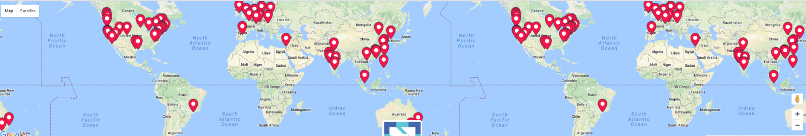
Conferences / Roadshows
In a bigger scale of community get together happens in conferences, roadshows, etc. CNCF organizes events at US, Europe and Asia at very big scale. One could participate in conference paper submissions, Birds of Feather discussion, panel discussion and also other logistics for the events. In addition there are CNCF roadshows happening all around the world and one could participate from the sponsorship to the technical content delivery. The ClouNativeCon just finished at Berlin Germany on March 28-30 http://events.linuxfoundation.org/events/cloudnativecon-and-kubecon-europe
Meetup
Code commit is just a one method to contribute. There are several other ways to contribute. Setting up a local meetup group is the simplest ones to start with. Organize regular sessions, hackathons and other hand-on activities to get the community learning going faster and attract new folks to the CNCF fold. Worldwide CNCF meetup groups information is available here http://www.meetup.com/pro/cncf/

Slide 19


